Slide 1
How do we avoid a new financial crisis?
www.patreon.com/profstevekeen
www.profstevekeen.com

Slide 2
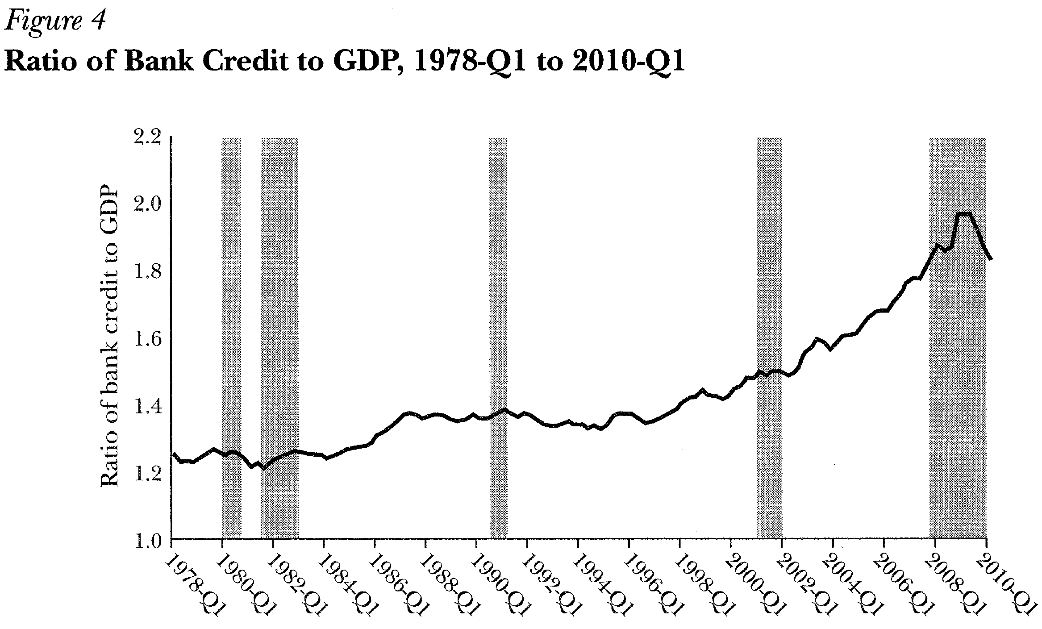
First step: Understand what caused the last one
Can’t understand it using mainstream economics
Leading mainstream economists dismiss financial explanation of crisis
Federal Reserve Advisor Lee Ohanian 2010: “Figure 4 … shows that bank credit relative to nominal GDP rose at the end of 2008 to an all-time high.
And while this declined by the first quarter of 2010, bank credit was still at a higher level at this point than any time before 2008.6”
This is the level of private sector debt
Credit is properly defined as the rate of change of private debt…

Slide 3
First step: Understand what caused the last one
This mistake is like confusing distance with speed:
Economist: “I was only 30 kilometres from Brussels, so I wasn’t speeding”
Judge: “You were doing 240 kilometres per hour. You were speeding!”
But it was made by a prominent mainstream economist
And not noticed by referees at a leading journal
Journal of Economic Perspectives
“Top 10” ranked journal, published by American Economic Association
How could leading economists make such a simple error?
Mainstream (Neoclassical) economics
Asserts money doesn’t affect “real” factors like employment
Builds macroeconomic models that omit banks, debt, and money
Like Ptolemaic astronomers modelling meteors without understanding gravity
So ignorant of monetary factors that they make simple definitional mistakes

Slide 4
First step: Understand what caused the last one
Let’s do better: this is the level of private debt from 1970 till 2018

Slide 5
First step: Understand what caused the last one
This is the rate of change of private debt from 1978 till 2018
Falls from peak at start of crisis
Massively negative during crisis

Slide 6
First step: Understand what caused the last one
This is the effect of credit on unemployment

Slide 7
First step: Understand what caused the last one
What’s going on?
Rising credit boosts aggregate demand and causes falling unemployment
BUT it also causes private debt to grow faster than GDP
When debt growth stops, credit falls and reduces aggregate demand
Credit can go strongly negative—this is made 2008 a crisis, rather than a recession
Not understood by mainstream economists because they assume away the role of finance and instability in the economy
Same factor applied in all countries that had a crisis—including Eurozone countries…

Slide 8
First step: Understand what caused the last one
Private Debt in Spain…

Slide 9
First step: Understand what caused the last one
Credit in Spain…
High Credit
Negative Credit

Slide 10
First step: Understand what caused the last one
Credit and Unemployment in Spain…

Slide 11
First step: Understand what caused the last one
Ditto Portugal…
High Credit
Negative Credit

Slide 12
First step: Understand what caused the last one
Ditto Greece…
High Credit
Negative Credit

Slide 13
First step: Understand what caused the last one
Countries that avoided 2008 crisis did so by either keeping credit positive (France)…
Medium Credit
Still positive Credit
At the expense of an even higher level of private debt…

Slide 14
First step: Understand what caused the last one
Or running a huge trade surplus so that private (& public) debt could fall (Germany)…
Low Credit throughout, thanks to high trade surplus

Slide 15
First step: Understand what caused the last one
“Recovery” has been via restoring credit growth, with private debt still too high
USA has “recovered”
Eurozone has not

Slide 16
First step: Understand what caused the last one
Fed “fight inflation” rate increases could trigger another “Roosevelt Recession”
Unemployment Doubles
Return to private sector deleveraging
Unemployment Explodes
Major Great Depression deleveraging

Slide 17
Why don’t mainstream economists understand credit?
Have a theory of banking in which banks don’t originate loans
“ If I decide to cut back on my spending and stash the funds in a bank, which lends them out to someone else, this doesn’t have to represent a net increase in demand.” (Krugman 2012)
Start from “a priori” assumption that money only affects prices not output
“the absence of money illusion … implies that aggregate demand fluctuations of a purely nominal nature should lead to price fluctuations only” (Lucas 1972, p.51)
Model the economy as if it is in/near equilibrium & inherently stable
“Why hasn’t growth theory been used to study the Great Depression? Perhaps because economists are reluctant to use standard theory to study an event that historically was treated as an aberration defying an equilibrium explanation.” (Prescott 1999)
Believe private debt doesn’t affect asset prices, & actually encourages debt finance
“We conclude therefore that levered companies cannot command a premium over unlevered companies because investors have the opportunity of putting the equivalent leverage into their portfolio directly by borrowing on personal account.” (Modigliani & Miller 1958)

Slide 18
Why don’t mainstream economists understand credit?
Bank of England & Bundesbank state that mainstream banking model is false
Bank of England: “Rather than banks receiving deposits when households save and then lending them out, bank lending creates deposits.”
Bundesbank: “this refutes a popular misconception that banks act simply as intermediaries at the time of lending – ie that banks can only grant credit using funds placed with them previously as deposits by other customers”
“Money illusion” invalid where loans don’t exist
Neoclassicals instead suffer from “barter illusion”
Model myth of money-less barter economy rather than monetary real world
Real world is always out of equilibrium. Irving Fisher put it best in 1933:
“New disturbances are, humanly speaking, sure to occur, so that, in actual fact, any variable is almost always above or below the ideal equilibrium…
It is as absurd to assume that, for any long period of time, the variables in the economic organization, or any part of them, will "stay put," in perfect equilibrium, as to assume that the Atlantic Ocean can ever be without a wave.”

Slide 19
Why don’t mainstream economists understand credit?
How to understand what mainstream economists refuse to understand:
Act I: Imagine spending by 3 people/sectors/countries, with no lending
“Angela”, “Emanuele” & “Alexis” each have €100 in cash
“Angela”, “Emanuele” & “Alexis” each spend €100 per year on each other
Act I: No borrowing. Total expenditure is total income: €600 per year
Expenditure & Income | Angela | Emanuele | Alexis
Angela | -200 | 100 | 100
Emanuele | 100 | -200 | 100
Alexis | 100 | 100 | -200
Diagonals are expenditure; off-diagonals are income
Each row necessarily sums to zero: Your Expenditure is someone else’s Income
Column sum is net savings per person/sector/country per year
Can be positive or negative, but the aggregate must be zero.

Slide 20
Why don’t mainstream economists understand credit?
Act II: No banks, but lending from one person to another
Angela borrows €10 from Emanuele to spend on Alexis; pays 10% interest
Emanuele finances loan by reducing his spending on Angela & Alexis
Total expenditure is total income equals €601/Year…
Expenditure & Income | Angela | Emanuele | Alexis
Angela | -(200+10+1) | 100+1 | 100+10
Emanuele | (100-5) | -(200-10) | (100-5)
Alexis | 100 | 100 | -200
€1 interest is expenditure for Angela and income for Emanuele
€10 credit-based spending cancels at the aggregate level
This is how mainstream economists think about credit
Transfers spending power from one person to another
Doesn’t change total spending power at all, whether debt is rising or falling

Slide 21
Why don’t mainstream economists understand credit?
Act III: Bank Originated Money and Debt (BOMD)
Angela takes out a loan of €10 from Bank & pays 10% interest to the Bank
Total expenditure is total income equals €612/Year…
Expenditure & Income | Angela | Emanuele | Alexis | Bank
Angela | -(200+10+1) | 100 | 100+10 | +1
Emanuele | 100 | -200 | 100
Alexis | 100 | 100 | -200
Bank |  | +0.5 | +0.5 | -1
€1 interest is expenditure for Angela and income for the Bank
Bank spends €1 interest income on Emanuele & Alexis
Expenditure by Bank is income for Emanuele & Alexis
€10 credit-based spending adds to both expenditure and income:
€10 Demand created by expenditure of new money by Angela is income for Alexis
Credit increases demand when positive, reduces demand when negative

Slide 22
How to avoid another financial crisis?
Don’t let private debt get too high
Don’t let credit become too big a factor in aggregate demand
And it’s too late… we’ve already done both
Private debt today is the highest level in the history of capitalism
Long term data exists for USA, UK, Australia
Mainstream economics encouraged this debt explosion…
Took off with deregulation of finance

Slide 23
How to avoid another financial crisis?
Finance needs to be made the servant not the master
Contrary to mainstream economics, debt does affect asset prices…

Slide 24
How to avoid another financial crisis?
Banks finance asset bubbles when they should finance productive investment

Slide 25
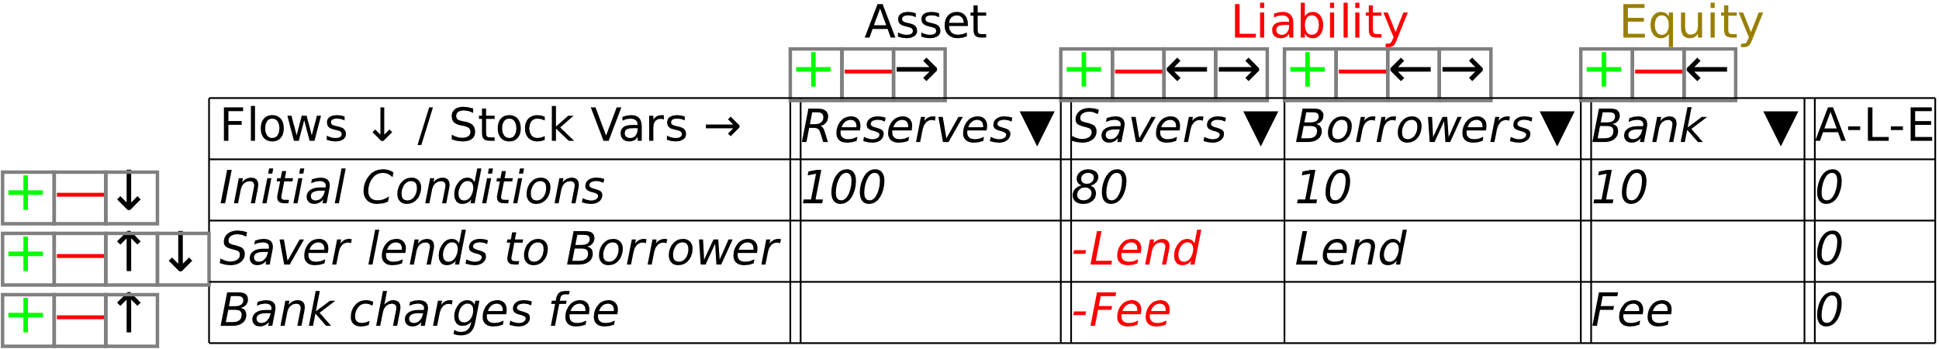
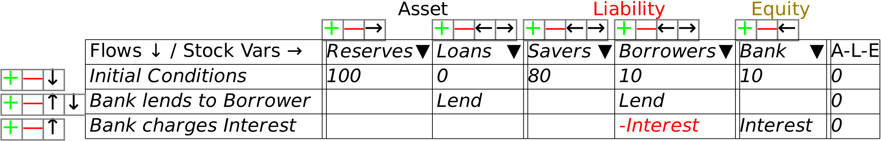
How to avoid another financial crisis?
Mainstream economics makes us think of banks as “money custodians”
No money created by lending
They’re actually “money factories”
Debt and money created by lending
Making a profit or a wage is hard;
“Making money” is easy: just double-entry bookkeeping…

Slide 26
How to avoid another financial crisis?
Banks can only “make money” because of banking licence granted by society
Gives society the right to
Control where banks can create money (productive investment not speculation)
Reverse mistakes made by unregulated lending for speculation
We could use Central Bank money creation ability to reverse private bank mistakes
Instead, Central Banks used “Quantitative Easing” to rescue them from mistakes
In USA, $1 Trillion per Year QE has inflated share prices
Benefited Banks and share owners
Increased inequality already made extreme by pre-crisis financial bubble…

Slide 27
How to avoid another financial crisis?
US Stock Market at 2nd highest level in history
Could use Central Banks’ money-creation ability for a “People’s QE”
Fiat money injected into the public’s bank accounts on per capita basis
No moral hazard or inflation:
Those with debt get a debt offset
Those without debt get fund that buys new corporate shares
Share revenue to firms must be used to reduce corporate debt
Reduce private debt burden
Reverse inequality caused by QE
Regulate banks to
Prevent future asset bubbles
Direct finance to industry rather than property

Slide 28
How to avoid another financial crisis?
Japan shows the alternative: stagnant demand with negative to low credit for decades…
Credit before crisis: 17% of GDP
25 Years
Credit after crisis: 0.6% of GDP
30 Years
Can Europe afford that many years of stagnation?

Slide 29
We need a new economics based on Realism not Ideology
Too high private debt & credit collapse caused Great Depression & Great Recession
How to understand? Abandon mainstream equilibrium thinking
Conventional economics is like Ptolemaic Astronomy:
Believe Economy (Universe) is inherently stable
Believe all instability is caused by “exogenous shocks”
Treat the financial sector as exogenous to the economy!
Now including it in post-crisis models as source of “frictions” that slow down return to equilibrium after a “shock”
We need a new, “Copernican” economics
Economy is inherently dynamic
Finance is an integral part of the economy
Instability is inherent to the economy and driven by finance
Minsky’s “Financial Instability Hypothesis”

Slide 30
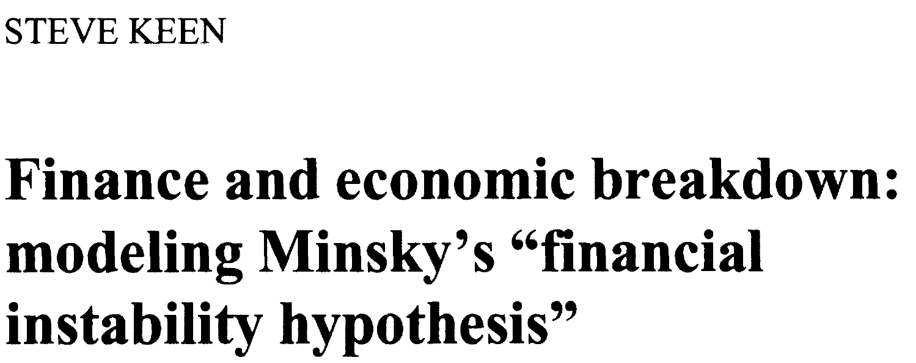
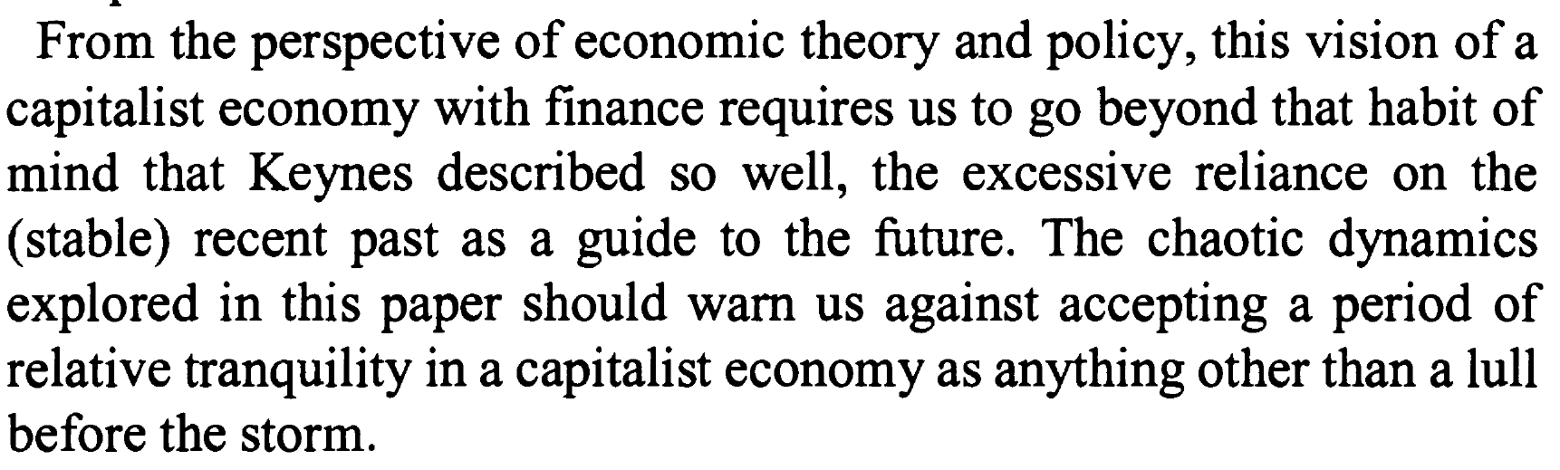
We need a new economics based on Realism not Ideology
Simple Minsky model easily derived from definitions:
Employment rate: Employment divided by Population
Income distribution: Wages divided by GDP
Private debt divided by GDP
Simple behaviours
Wages depend on employment
Investment depends profit
Debt finances investment
Outcomes
Economy can be stable if private debt & credit remain low
High level of private debt & credit leads to crisis
Model warned of potential for crisis two decades before it happened (Keen 1995)
“The chaotic dynamics explored in this paper should warn us against accepting a period of relative tranquillity in a capitalist economy as anything other than a lull before the storm.”

Slide 31
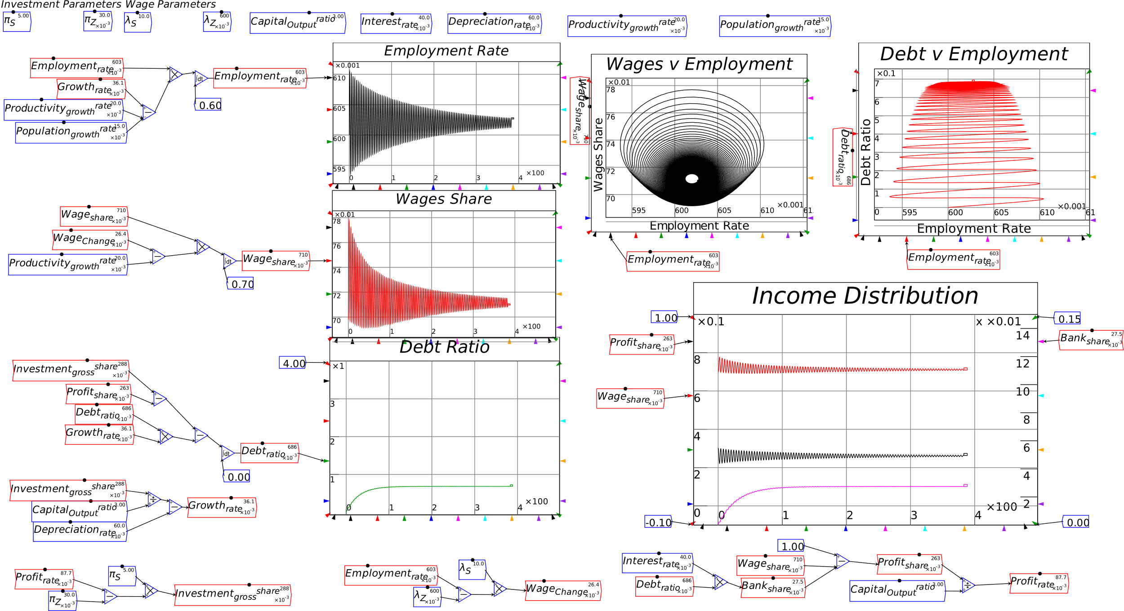
We need a new economics based on Realism not Ideology
Stability if private debt remains low…

Slide 32
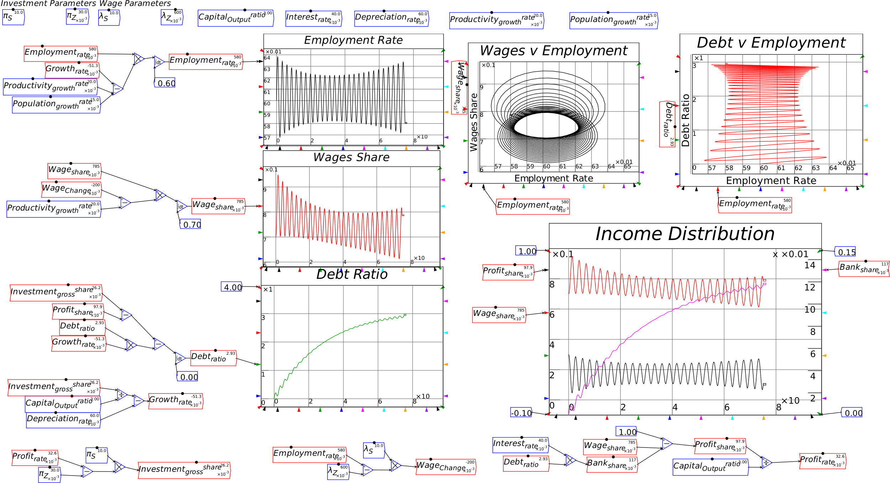
We need a new economics based on Realism not Ideology
Apparent stability (“Great Moderation”) then breakdown if it gets too high…

Slide 33
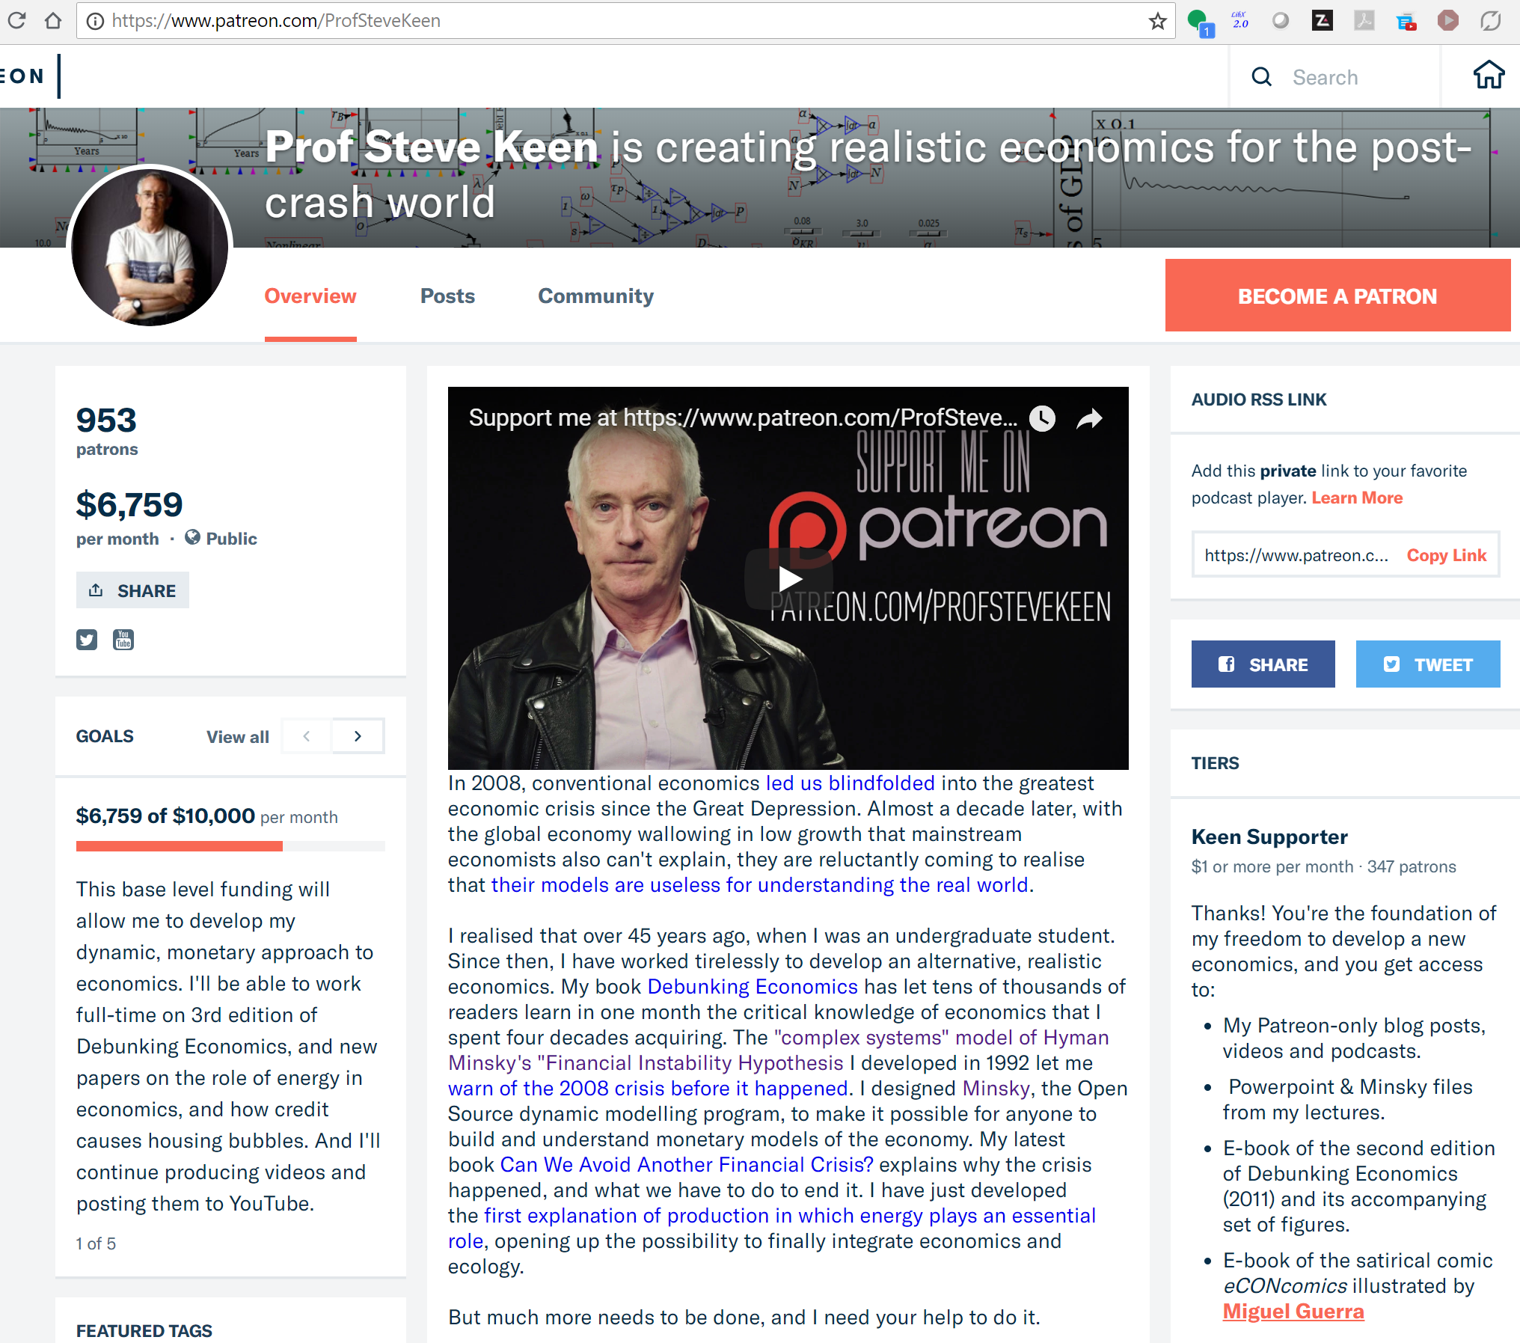
We need a new economics based on Realism not Ideology
Universities and funding agencies too dominated by mainstream economics
We need to work outside the universities to develop a new economics
Support Rethinking Economics student movement
I’ve turned to crowdfunding to develop a new economics, away from the intellectual conformity of today’s universities…
For more: https://www.patreon.com/ProfSteveKeen

Slide 34
References
Deutsche Bundesbank (2017). "The role of banks, non- banks and the central bank in the money creation process." Deutsche Bundesbank Monthly Report: 13-33.
Fisher, I. (1933). "The Debt-Deflation Theory of Great Depressions." Econometrica 1(4): 337-357.
Keen, S. (1995). "Finance and Economic Breakdown: Modeling Minsky's 'Financial Instability Hypothesis.'." Journal of Post Keynesian Economics 17(4): 607-635.
Krugman, P. (2012). "Minsky and Methodology (Wonkish)." The Conscience of a Liberal http://krugman.blogs.nytimes.com/2012/03/27/minksy-and-methodology-wonkish/.
Lucas, R. E., Jr. (1972). Econometric Testing of the Natural Rate Hypothesis. The Econometrics of Price Determination Conference, October 30-31 1970. O. Eckstein. Washington, D.C., Board of Governors of the Federal Reserve System and Social Science Research Council: 50-59.
McLeay, M., A. Radia and R. Thomas (2014). "Money creation in the modern economy." Bank of England Quarterly Bulletin 2014 Q1: 14-27.
Minsky, H. P. (1982). Can "it" happen again? : essays on instability and finance. Armonk, N.Y., M.E. Sharpe.
Modigliani, F. and M. Miller (1958). "The Cost of Capital, Corporation Finance and the Theory of Investment." American Economic Review 48(3): 261–297.
Ohanian, L. E. (2010). "The Economic Crisis from a Neoclassical Perspective." Journal of Economic Perspectives 24(4): 45-66.
Prescott, E. C. (1999). "Some Observations on the Great Depression." Federal Reserve Bank of Minneapolis Quarterly Review 23(1): 25-31.

